Slide 1
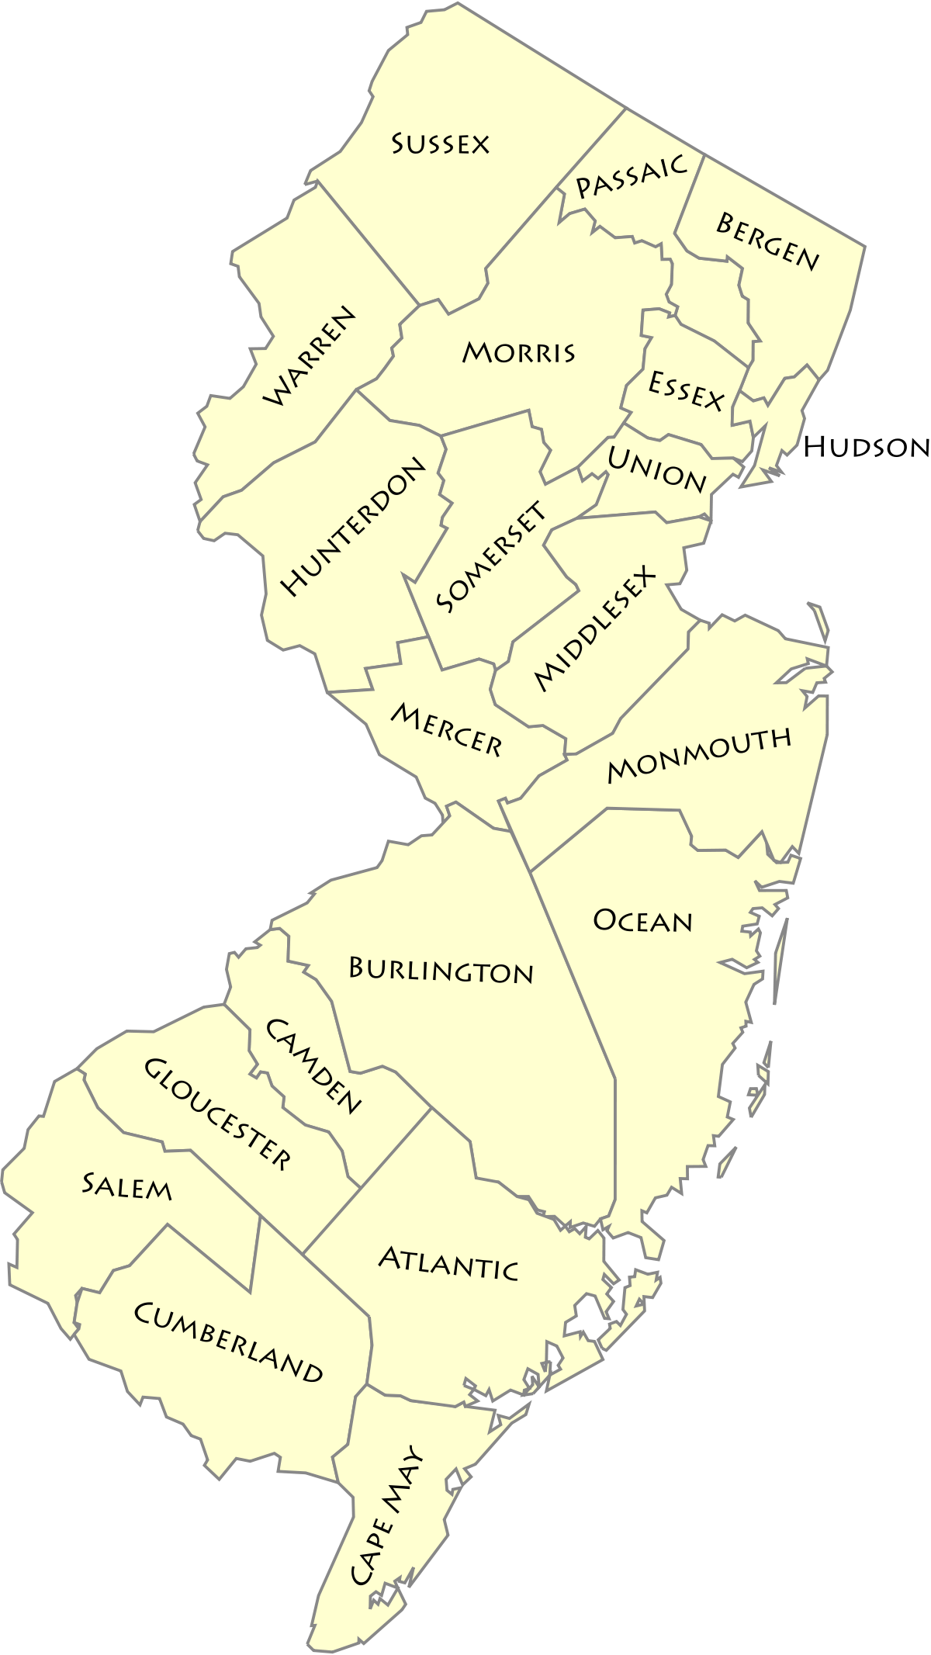
New Jersey Tax Form 1040
This Photo by Unknown Author is licensed under CC BY-SA
This Photo by Unknown Author is licensed under CC BY-SA

Slide 2
New Jersey 1040 Introduction
NJ 1040 looks different than the Federal 1040
NJ paper return looks different than the NJ electronic return
Same line numbers
We will use the paper return for this presentation because it is easier to read.
10-06-2020 v0.94

Slide 3
Income Section of NJ Electronic Return
NJ Electronic 1040
NJ Paper 1040

Slide 4
Download NJ 1040
If you have a copy of the TY 2019 NJ 1040 booklet, get it out at this time.
If you don’t, download a copy of the TY 2019 NJ 1040 and print it so that you can follow along. Link below
2019 New Jersey Resident Return, Form NJ-1040 (state.nj.us)

Slide 5
NJ 1040 Page 1 Top
Personal information
Municipality Code
Filing Status

Slide 6
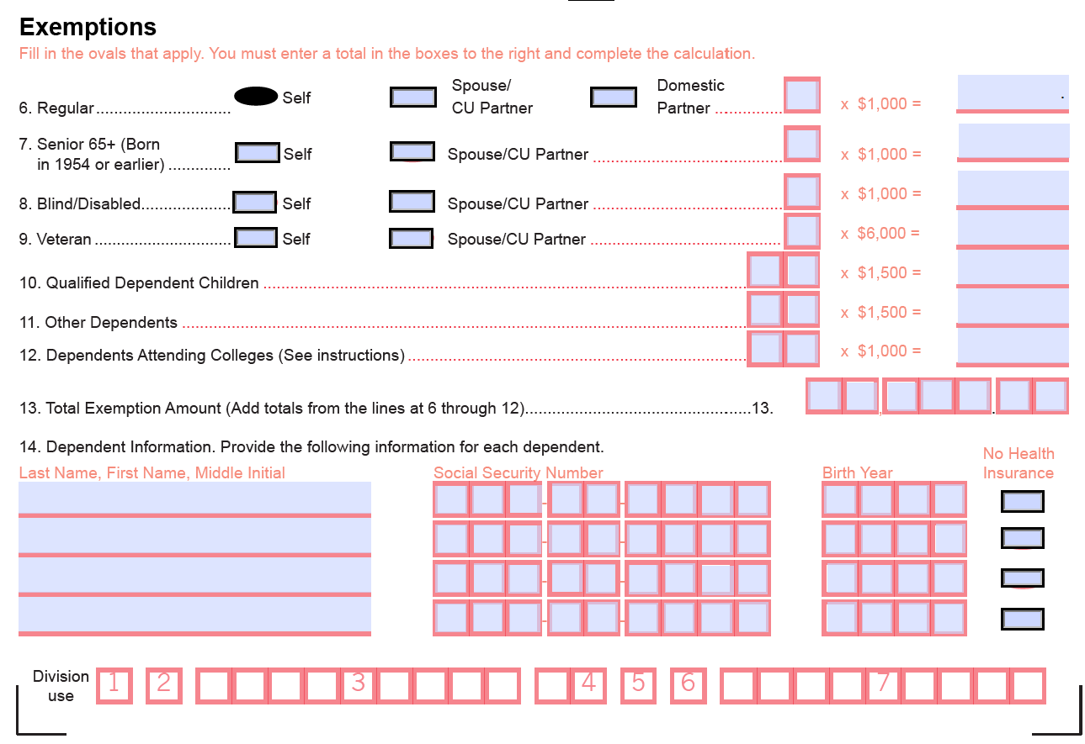
NJ 1040 Page 1 Bottom
Exemptions
On the NJ return the TP gets $$ exemptions
Dependent info from Federal return

Slide 7
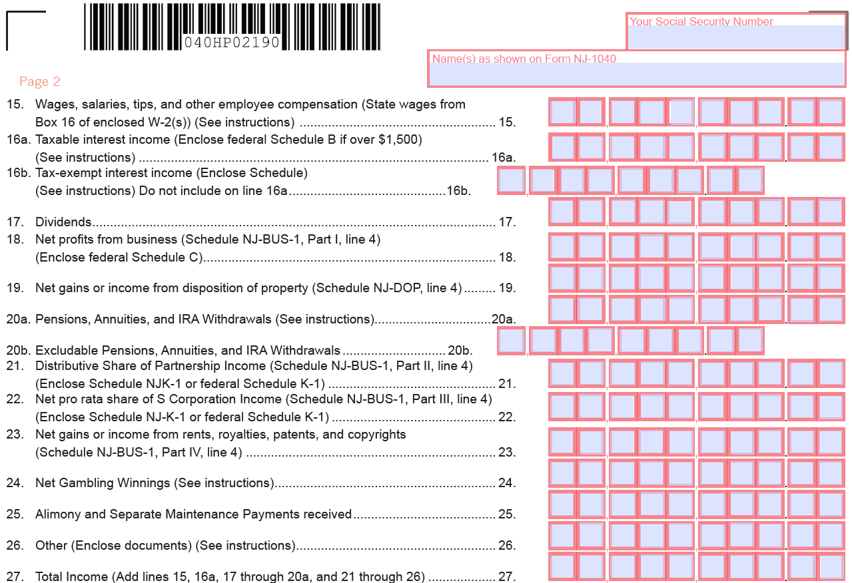
NJ 1040 Page 2 -Income
Most income transfers in from the Federal return
May have to modified
May have to be added
Line 27 = total NJ income

Slide 8
NJ 1040 – Exclusions & Gross Income
Retirement/Pension exclusions reduces total income
Over 62, blind or disabled
“New Jersey Gross Income” is like federal Adjusted Gross Income.

Slide 9
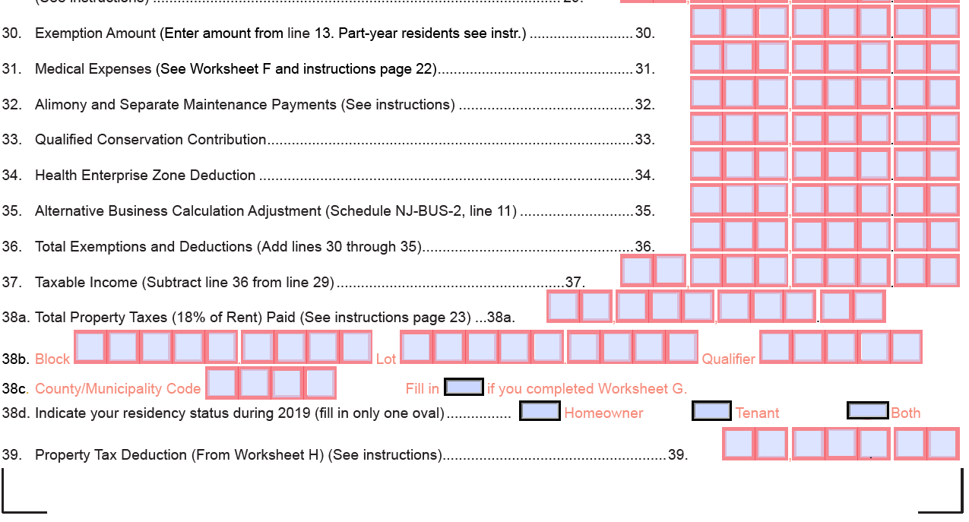
NJ 1040- Exemptions and Deductions
Exemptions and deductions are subtracted to arrive at Taxable income
Property tax deduction entered

Slide 10
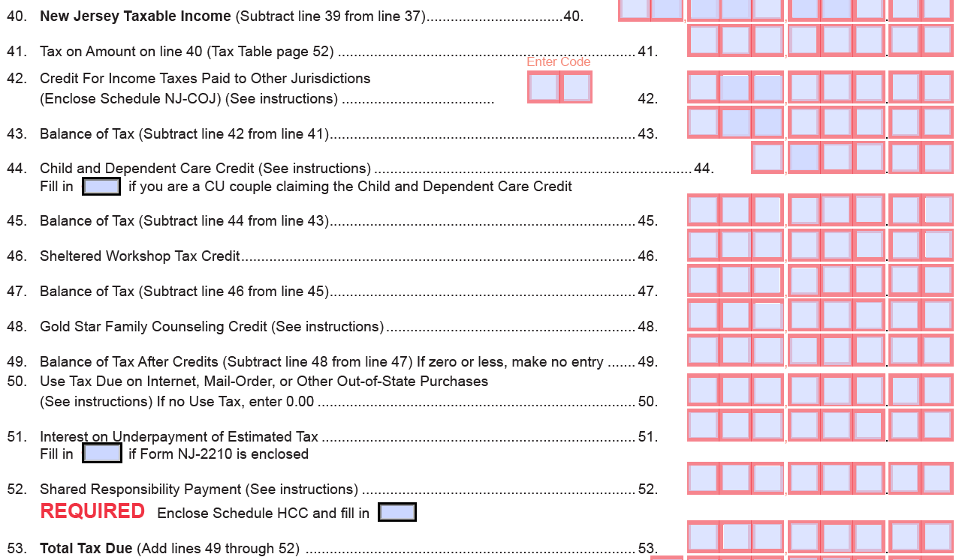
NJ 1040 – Page 3 Calculation of total tax due
NJ taxable income
Various credits and additional taxes are applied.
Line 53 = Total Tax Due

Slide 11
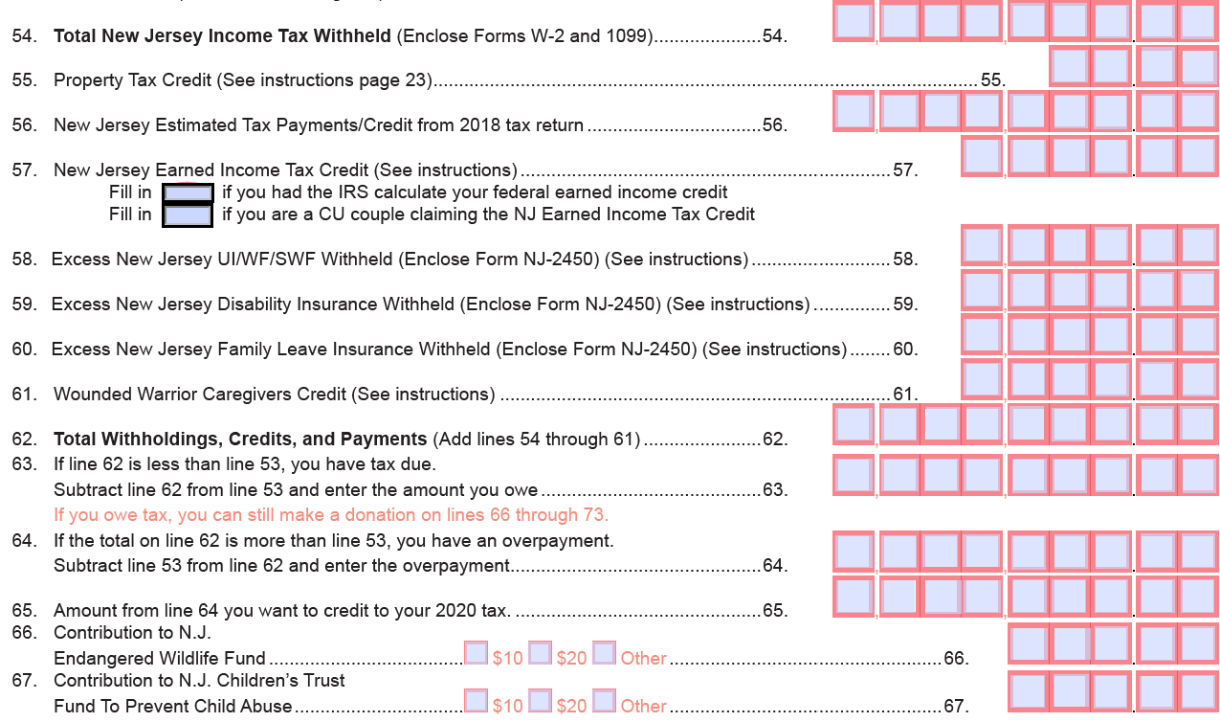
NJ 1040 – Calculation of refund or owe
Payments totaled are subtracted from Total Tax Due.
Amount of refund to be credited to next year
Result is refund due or tax due
Voluntary contributions

Slide 12
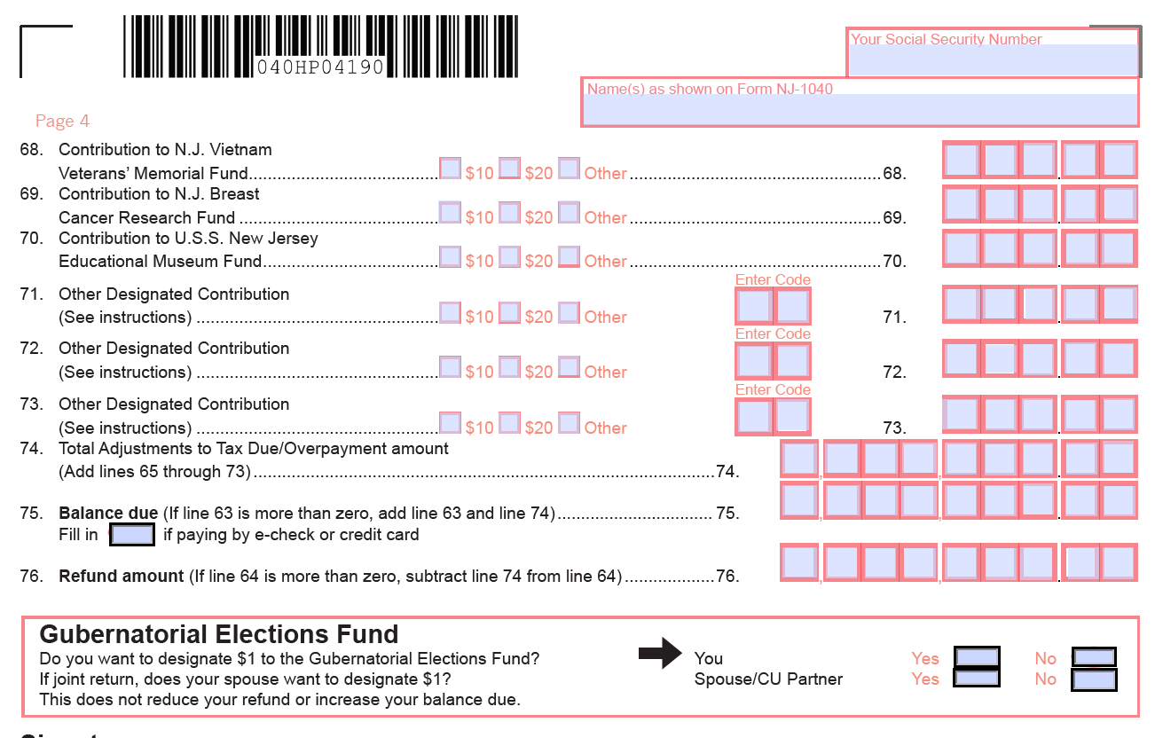
NJ 1040 – Final Calculation of owed or due
Voluntary Contributions
Line 75 – Balance Due
Line 76 Tefund amount
Gubernatorial Election Fund Question

Slide 13
NJ- 1040-Signature Box
The software completes the Signature box information.
Taxpayer signs Federal form 8879
10-06-2020 v0.94

Slide 14
Questions
Questions
10-06-2020 v0.94

